Slide 1

Chapter 3
Underlying Technology
Copyright © The McGraw-Hill Companies, Inc. Permission required for reproduction or display.

Slide 2
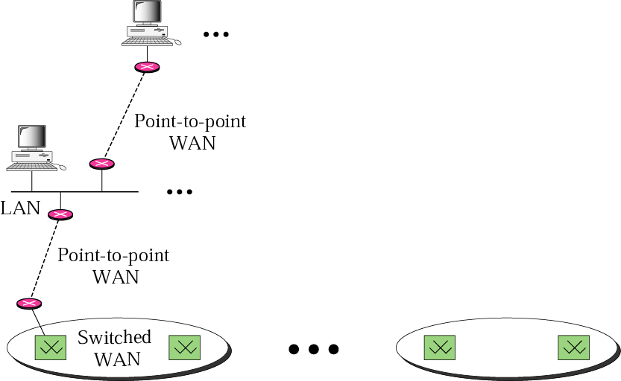
Internet Model
It relies on the theoretical and practical application of the related disciplines
Internet不是一种新的网络
建立在底层网络上的网际网
底层网络——“物理网”
网际网——“互联网”
物理网为上层提供通信支持
互联网的“信道”或“接口”
Notes:
Computer networking may be considered a branch of computer science , computer engineering , and telecommunications , since it relies on the theoretical and practical application of the related disciplines.

Slide 3
OBJECTIVES:
To briefly discuss the technology of dominant wired LANs, Ethernet, including traditional, fast, gigabit, and ten-gigabit Ethernet.
To briefly discuss the technology of wireless WANs, including IEEE 802.11 LANs, and Bluetooth.
To briefly discuss the technology of point-to-point WANs including 56K modems, DSL, cable modem, T-lines, and SONET.
To briefly discuss the technology of switched WANs including X.25, Frame Relay, and ATM.
To discuss the need and use of connecting devices such as repeaters (hubs), bridges (two-layer switches), and routers (three-layer switches).

Slide 4
Chapter Outline
3.1 Wired Local Area Network
3.2 Wireless LANs
3.3 Point-to-Point WANs
3.4 Switched WANs
3.5 Connecting Devices

Slide 5
3-1 WIRED LOCAL AREA NETWORKS
A local area network (LAN) is a computer network that is designed for a limited geographic area such as a building or a campus. Although a LAN can be used as an isolated network to connect computers in an organization for the sole purpose of sharing resources, most LANs today are also linked to a wide area network (WAN) or the Internet.

Slide 6
Topics Discussed in the Section
IEEE Standards
Frame Format
Addressing
Ethernet Evolution
Standard Ethernet
Fast Ethernet
Gigabit Ethernet
Ten-Gigabit Ethernet

Slide 7
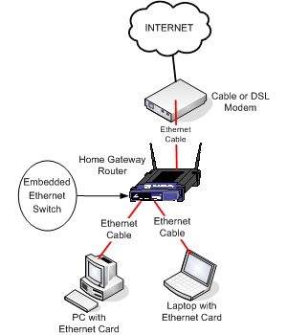
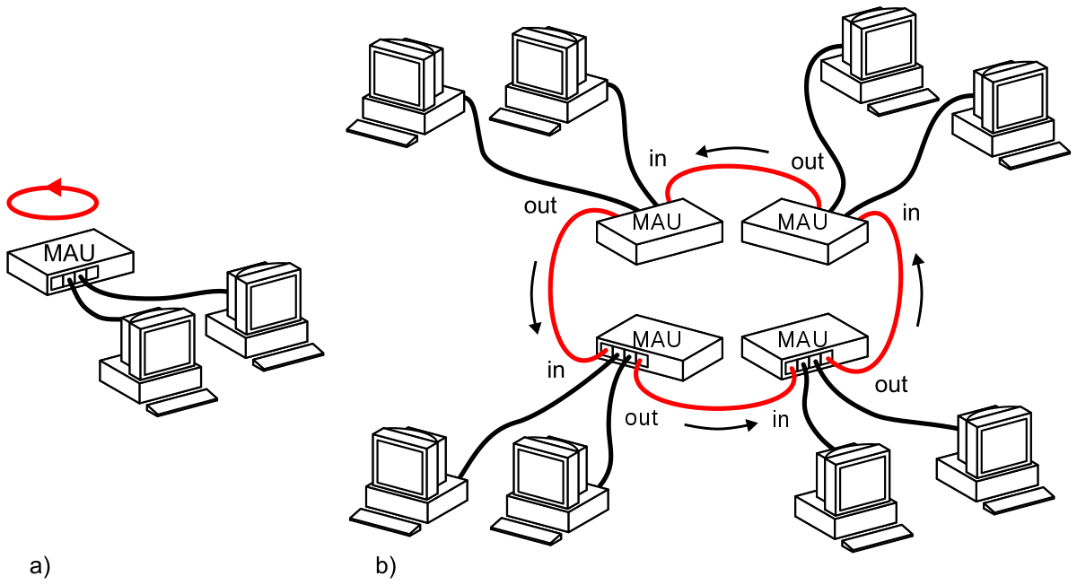
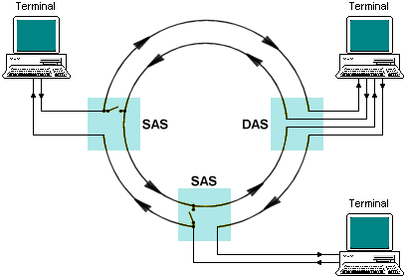
STANDARDS PERSPECTIVE
The LAN market has seen several technologies such as Ethernet, token ring, token bus, FDDI, and ATM LAN, but Ethernet is by far the dominant technology.
Notes:
Fiber distribute data interface

Slide 8
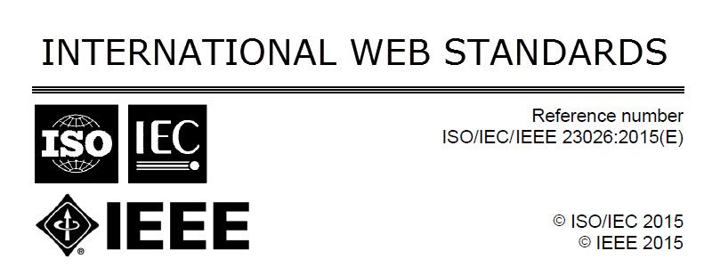
STANDARDS PERSPECTIVE
Standards are developed through the cooperation of standards creation committees, forums, and government regulatory agencies.
An example

Slide 9
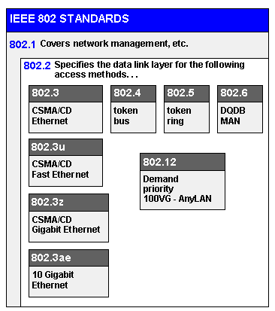
STANDARDS PERSPECTIVE
In 1985, the Computer Society of the IEEE started a project, called Project 802, to set standards to enable intercommunication among equipment from a variety of manufacturers.

Slide 10
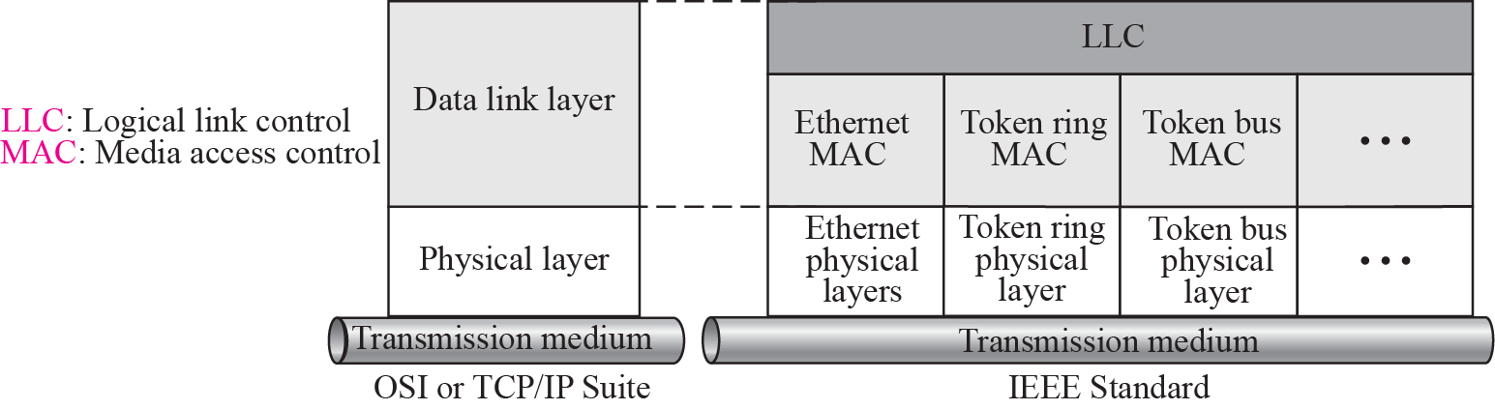
Figure 3.1 IEEE standard for LANs
Project 802 does not seek to replace any part of the OSI or the Internet model.Instead, it is a way of specifying functions of the physical layer and the data link layer of major LAN protocols.
The IEEE has subdivided the data link layer into two sublayers: logical link
control (LLC) and media access control (MAC). IEEE has also created several physical layer standards for different LAN protocols.
Notes:
The standard was adopted by the American National Standards Institute (ANSI). In 1987, the International Standards Organization (ISO) also approved it as an international standard under the designation ISO 8802.

Slide 11
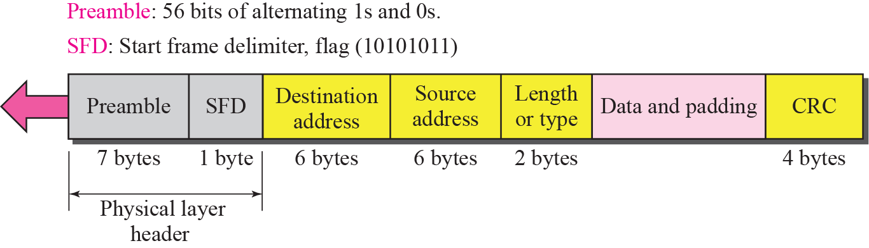
Figure 3.2 Ethernet Frame
Notes:
The second field (1 byte: 10101011) signals the beginning of the frame. The SFD warns the station or stations that this is the last chance for synchronization. The last 2 bits are 11 and alert the receiver that the next field is the destination address.

Slide 12
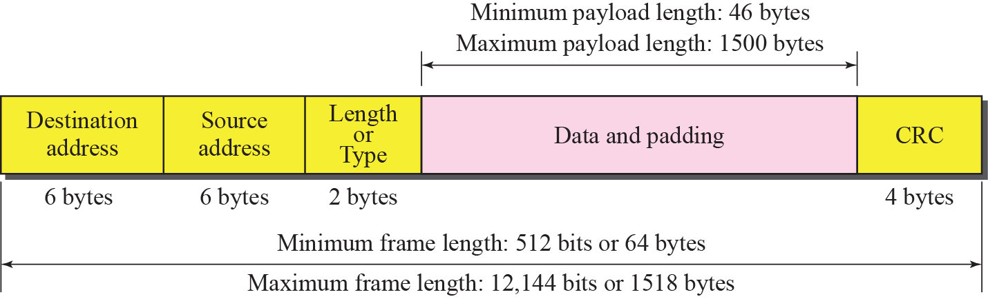
Figure 3.3 Maximum and minimum lengths
The maximum length restriction has two historical reasons.
First, memory was very expensive when Ethernet was designed: a maximum
length restriction helped to reduce the size of the buffer.
Second, the maximum length restriction prevents one station from monopolizing the shared medium.
Notes:
The minimum length restriction is required for the correct operation of CSMA/CD, as we will see shortly.

Slide 13

Note
Minimum length: 64 bytes (512 bits) Maximum length: 1518 bytes (12,144 bits)

Slide 14
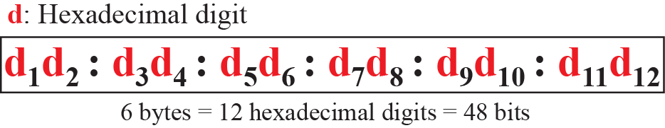
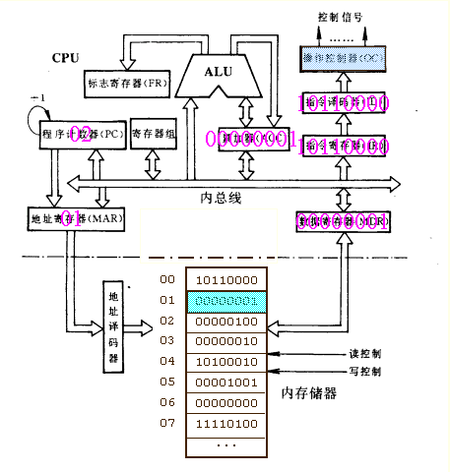
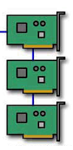
Figure 3.4 Ethernet address in hexadecimal notation
The network interface card(NIC) fits inside the station and provides the station with a 6-byte physical address.
NIC
Notes:
most local area networks use a 48-bit (6-byte) physical address written as 12 hexadecimal digits

Slide 15
Figure 3.5 Unicast and multicast addresses

Slide 16
Note
The broadcast destination address is a special case of the multicast address
in which all bits are 1s.

Slide 17
Note
The least significant bit of the first byte defines the type of address.
If the bit is 0, the address is unicast; otherwise, it is multicast.

Slide 18
Example 3.1
Define the type of the following destination addresses:
a. 4A:30:10:21:10:1A
b. 47:20:1B:2E:08:EE
c. FF:FF:FF:FF:FF:FF
Solution
To find the type of the address, we need to look at the second
hexadecimal digit from the left. If it is even, the address is unicast. If it is odd, the address is multicast. If all digits are F’s, the address is broadcast. Therefore, we have the following:
a. This is a unicast address because A in binary is 1010 (even).
b. This is a multicast address because 7 in binary is 0111 (odd).
c. This is a broadcast address because all digits are F’s.

Slide 19
Example 3.2
The way the addresses are sent out on line is different from the way they are written in hexadecimal notation.
Show how the address 47:20:1B:2E:08:EE is sent out on line.
Solution
The address is sent left-to-right, byte by byte; for each byte, it is sent right-to-left, bit by bit, as shown below:
← 11100010 00000100 11011000 01110100 00010000 01110111

Slide 20
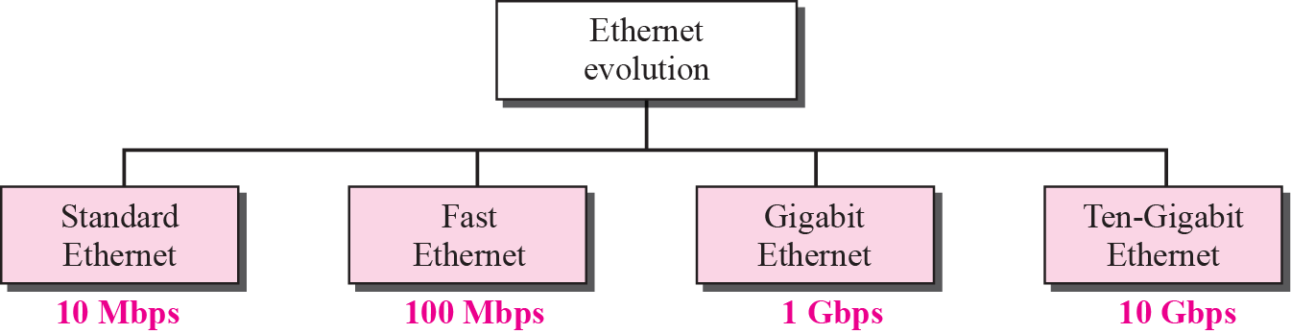
Figure 3.6 Ethernet evolution through four generations
Ethernet was created in 1976 at Xerox’s Palo Alto Research Center (PARC). Since then, it has gone through four generations

Slide 21
Figure 3.7 Space/time model of a collision in CSMA
A
B
C
D
T
i
m
e
T
i
m
e
Notes:
The original Ethernet with 10-Mbps data rate is now history, but we briefly discuss its characteristics to pave the way for understanding other Ethernet versions. The IEEE 802.3 standard defines carrier sense multiple access with collision detection (CSMA/CD) as the access method for traditional Ethernet.

Slide 22
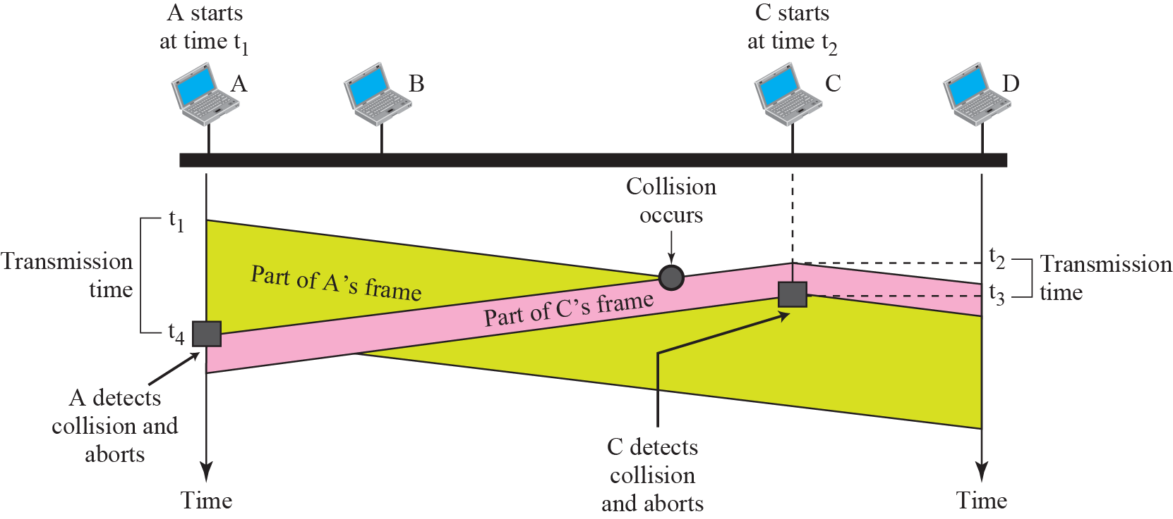
Figure 3.8 Collision of the first bit in CSMA/CD

Slide 23
Example 3.3
In the standard Ethernet, if the maximum propagation time is 25.6 μs, what is the minimum size of the frame?
Solution
The frame transmission time is T_{fr} = 2 × T_{p} = 51.2 μs. This means, in the worst case, a station needs to transmit for a period of 51.2 μs to detect the collision. The minimum size of the frame is 10 Mbps × 51.2 μs = 512 bits or 64 bytes. This is actually the minimum size of the frame for Standard Ethernet, as we discussed before.

Slide 24
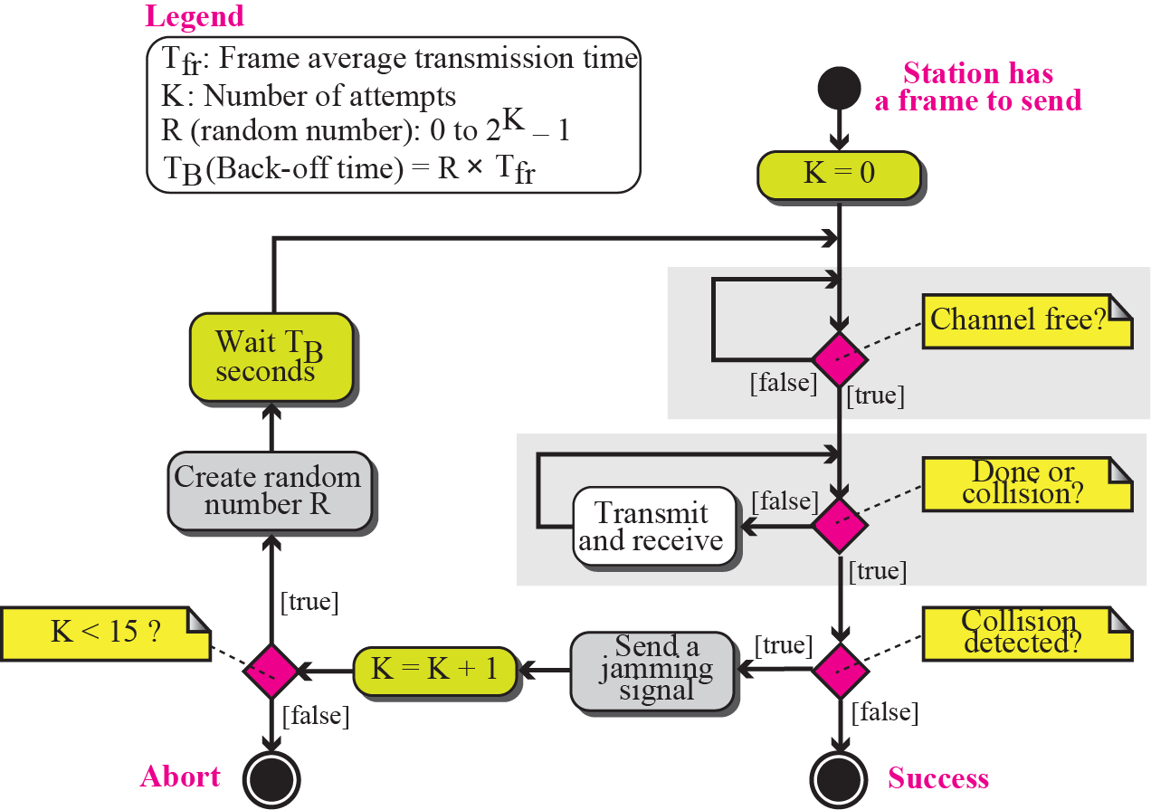
Figure 3.9 CSMA/CD flow diagram

Slide 25
Implementation
The number defines the data rate (10 Mbps)
The term Base means baseband (digital) signal
X approximately defines either the
maximum size of the cable in 100 meters
Notes:
The Standard Ethernet defined several implementations, but only four of them became popular during ’80s.

Slide 26
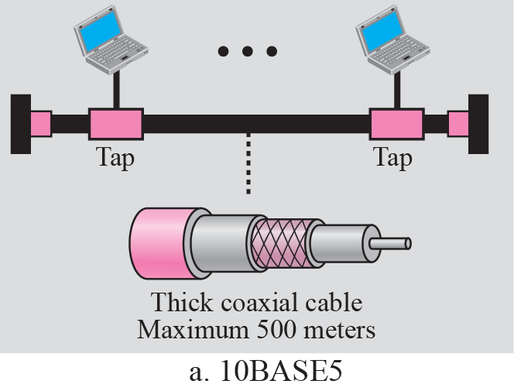
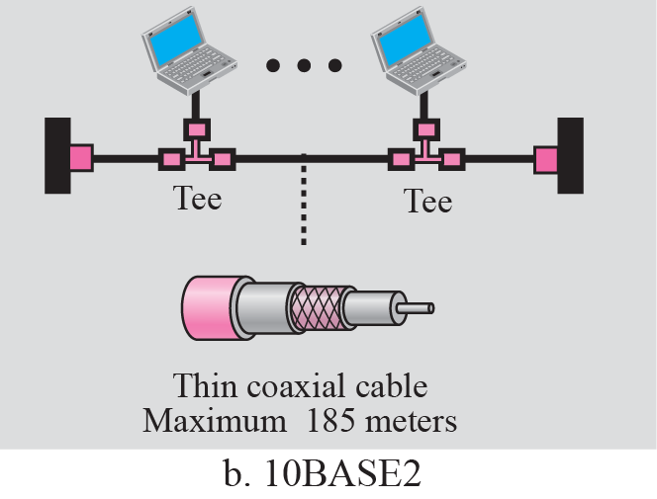
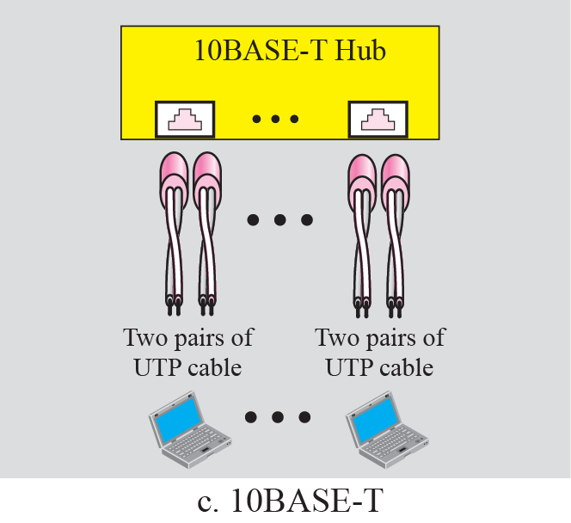
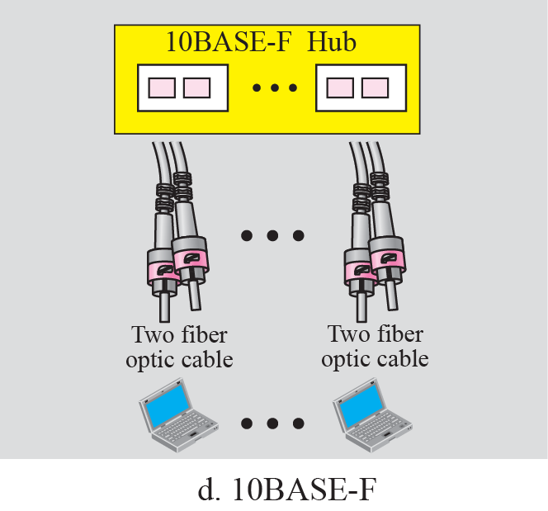
Figure 3.10 Standard Ethernet implementation
Notes:
T for unshielded twisted pair cable (UTP) and F for fiber-optic

Slide 27
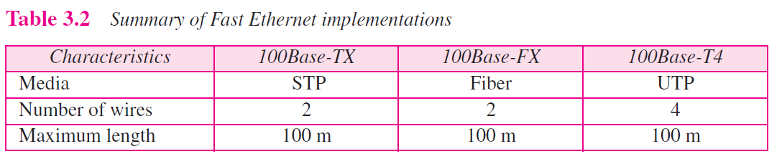
Fast Ethernet
It was designed to compete with LAN protocols such as FDDI or Fiber Channel.
Notes:
Fast Ethernet implementation at the physical layer can be categorized as either two-wire or four-wire. The two-wire implementation can be either shielded twisted pair, STP (100Base-TX) or fiber-optic cable (100Base-FX). The four-wire implementation is designed only for unshielded twist pair, UTP (100Base-T4)

Slide 28
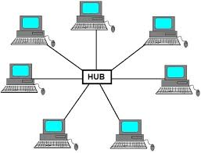
Fast Ethernet
MAC Sublayer
A decision was made to drop the bus topologies and keep only the star topology. For the star topology, there are two choices:
Half duplex and full duplex.

Slide 29
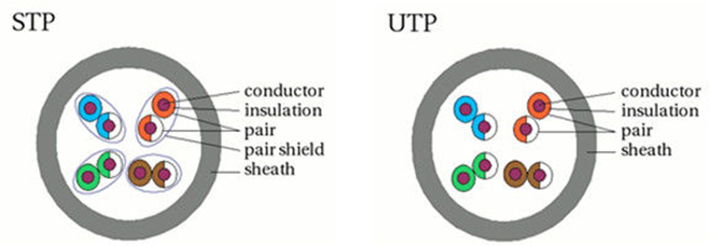
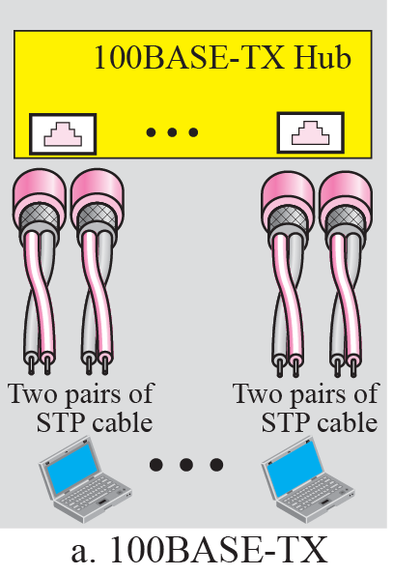
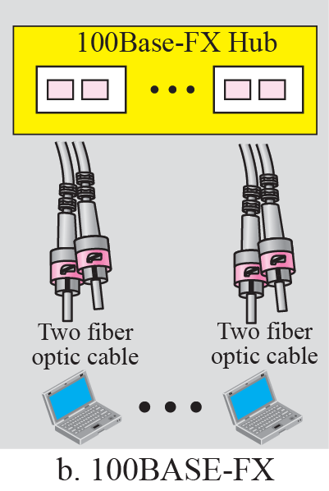
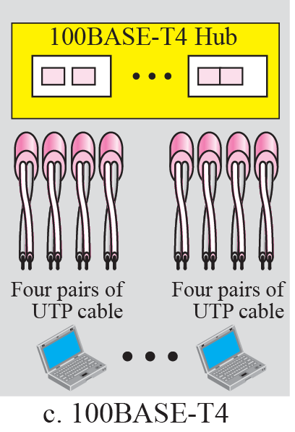
Figure 3.11 Fast Ethernet implementation

Slide 30
Gigabit Ethernet
The need for an even higher data rate resulted in the design of the Gigabit Ethernet Protocol (1000 Mbps). The IEEE committee calls the Standard 802.3z.
Notes:
1. Upgrade the data rate to 1 Gbps. 2. Make it compatible with Standard or Fast Ethernet. 3. Use the same 48-bit address. 4. Use the same frame format. 5. Keep the same minimum and maximum frame lengths. 6. To support autonegotiation as defined in Fast Ethernet.

Slide 31
Gigabit Ethernet
MAC Sublayer
Almost all implementations of Gigabit Ethernet follow the full-duplex
approach.
In full-duplex mode, there is a central switch connected to all
computers or other switches. In this mode, each switch has buffers for each input port in which data are stored until they are transmitted.
The half-duplex approach uses CSMA/CD.
Traditional. the maximum length of the network is 25 m
Carrier Extension. the minimum length of a frame as 512 bytes
Frame Bursting. make these multiple frames look like one frame

Slide 32
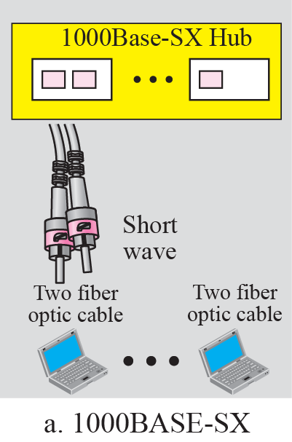
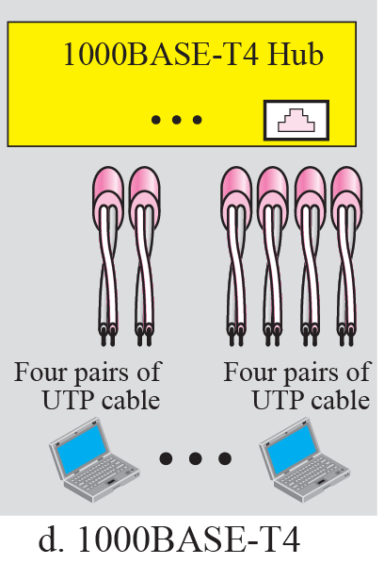
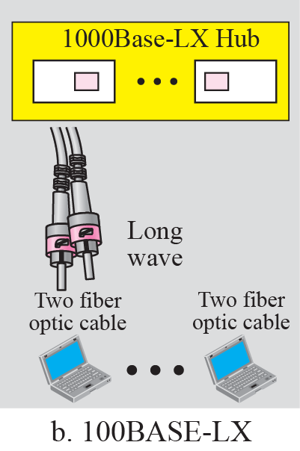
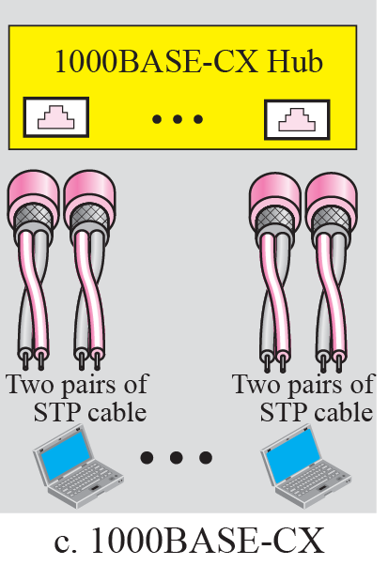
Figure 3.12 Gigabit Ethernet implementation

Slide 33
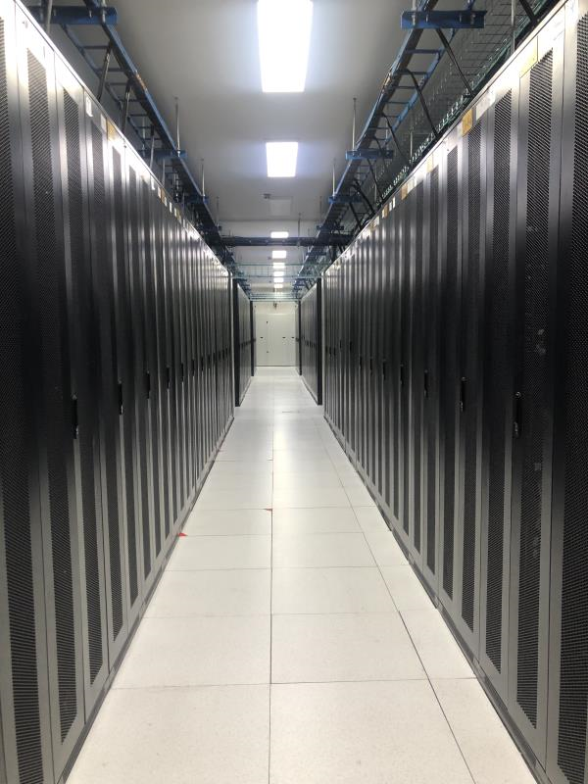
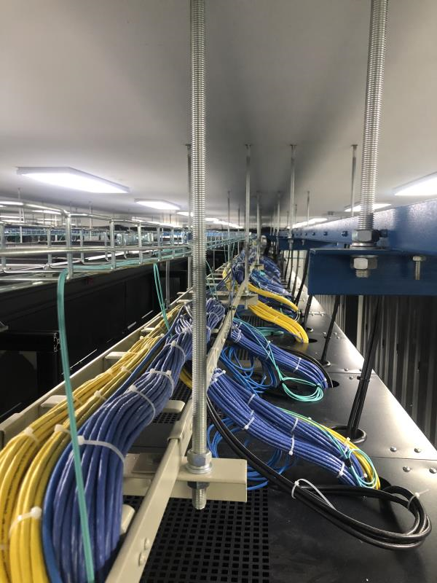
Figure 3.12 Gigabit Ethernet implementation

Slide 34
Note
In the full-duplex mode of Gigabit Ethernet, there is no collision;
the maximum length of the cable is determined by the signal attenuation in the cable.

Slide 35
Ten-Gigabit Ethernet
The IEEE committee created Ten-Gigabit Ethernet and called it Standard 802.3ae.
The goals of the Ten-Gigabit Ethernet design can be summarized as follows:
Upgrade the data rate to 10 Gbps.
Make it compatible with Standard, Fast, and Gigabit Ethernet.
Use the same 48-bit address.
Use the same frame format.
Keep the same minimum and maximum frame lengths.
Allow the interconnection of existing LANs into a metropolitan area network (MAN) or a wide area network (WAN).
Make Ethernet compatible with technologies such as Frame Relay and ATM.

Slide 36
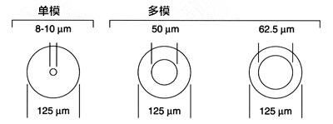
Notes:
模式是指一个电磁波在确定方向传播时不同的特性。 光纤中的模式是满足亥姆霍兹方程的解。并不是所有入射到光纤中的光都可以稳定的传输，只有入射角和偏振状态满足一定条件才可以传播。光纤可以传播的模式数和波长、光纤的半径、折射率有关。 单模光纤就是在确定的光纤参数和波长下，可以传播的光的模式只有一个。 多模光纤是指这个光纤允许多种模式的光传播。

Slide 37
单模光纤和多模光纤
多模光纤（multi-mode fiber）
使用普通发光二极管作为光源
中继距离2公里
内芯直径稍大
直径为62.5μm/125μm
单模光纤（single-mode fiber）
使用激光源
中继距离100公里
内芯直径与光源波长相近
直径为8～10μm
Notes:
模式是指一个电磁波在确定方向传播时不同的特性。 光纤中的模式是满足亥姆霍兹方程的解。并不是所有入射到光纤中的光都可以稳定的传输，只有入射角和偏振状态满足一定条件才可以传播。光纤可以传播的模式数和波长、光纤的半径、折射率有关。 单模光纤就是在确定的光纤参数和波长下，可以传播的光的模式只有一个。 多模光纤是指这个光纤允许多种模式的光传播。

Slide 38
Chapter Outline
3.1 Wired Local Area Network
3.2 Wireless LANs
3.3 Point-to-Point WANs
3.4 Switched WANs
3.5 Connecting Devices

Slide 39
3-2 WIRELESS LANS
Wireless communication is one of the fastest growing technologies. The demand for connecting devices without the use of cables is increasing everywhere. Wireless LANs can be found on college campuses, in office buildings, and in many public areas. In this section, we concentrate on two wireless technologies for LANs: IEEE 802.11 wireless LANs, sometimes called wireless Ethernet, and Bluetooth, a technology for small wireless LANs.

Slide 40
Topics Discussed in the Section
IEEE 802.1
MAC Sublayer
Addressing Mechanism
Bluetooth

Slide 41
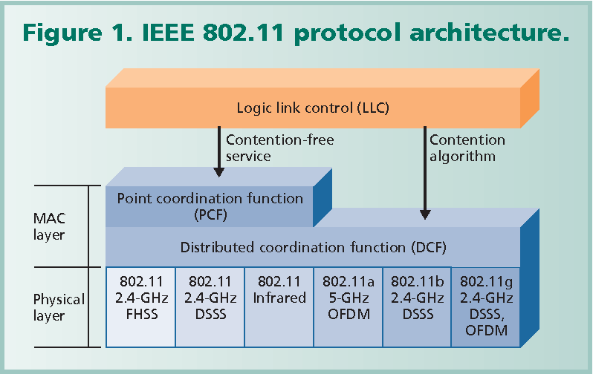
802.11
Notes:
IEEE has defined the specifications for a wireless LAN, called IEEE 802.11, which covers the physical and data link layers.

Slide 42
Note
The physical layer is responsible for moving individual bits from one
(node) to the next.

Slide 43
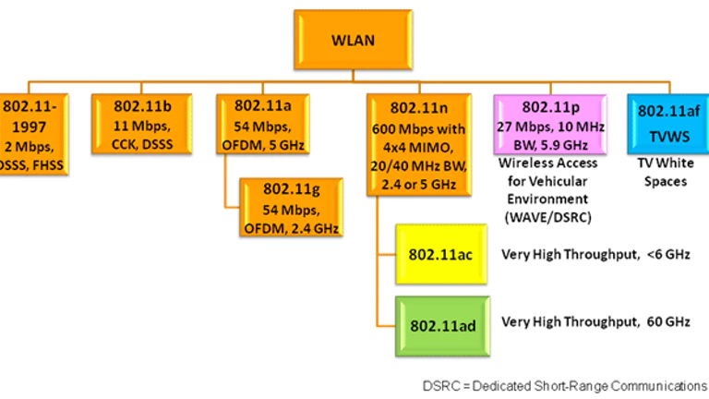
802.11

Slide 44
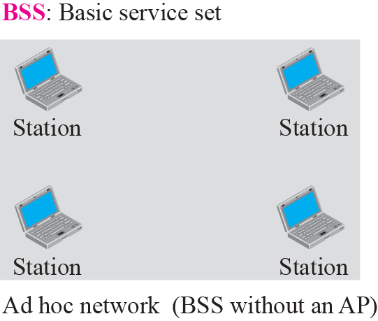
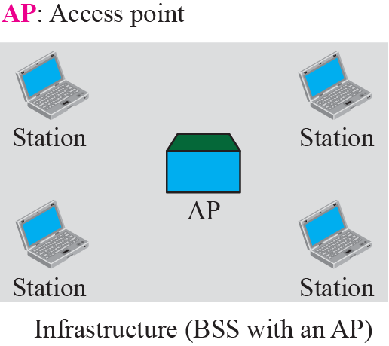
Figure 3.13 Basic service sets (BSSs)
Architecture
The standard defines two kinds of services: the basic service set (BSS) and the extended service set (ESS).
Notes:
A basic service set is made of stationary or mobile wireless stations and an optional central base station, known as the access point (AP).

Slide 45
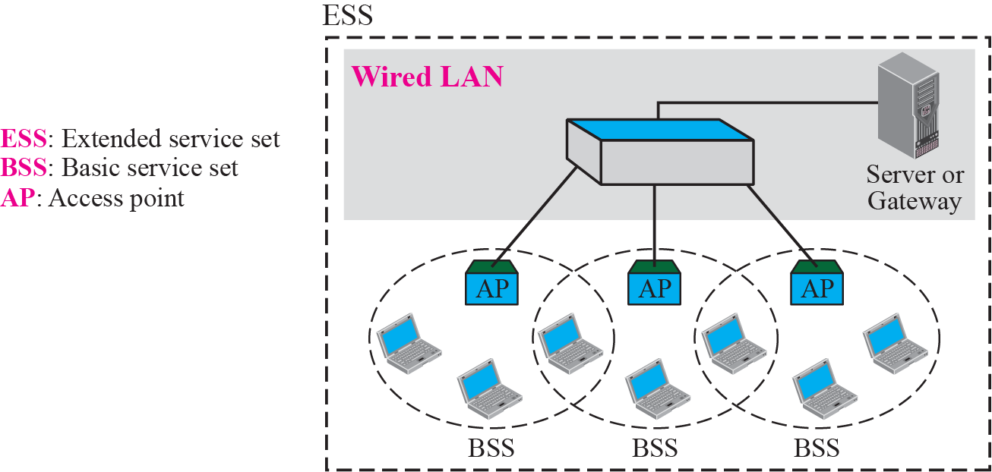
Figure 3.14 Extended service sets (ESSs)
Notes:
An extended service set (ESS) is made up of two or more BSSs with APs. In this case, the BSSs are connected through a distribution system, which is usually a wired LAN.

Slide 46
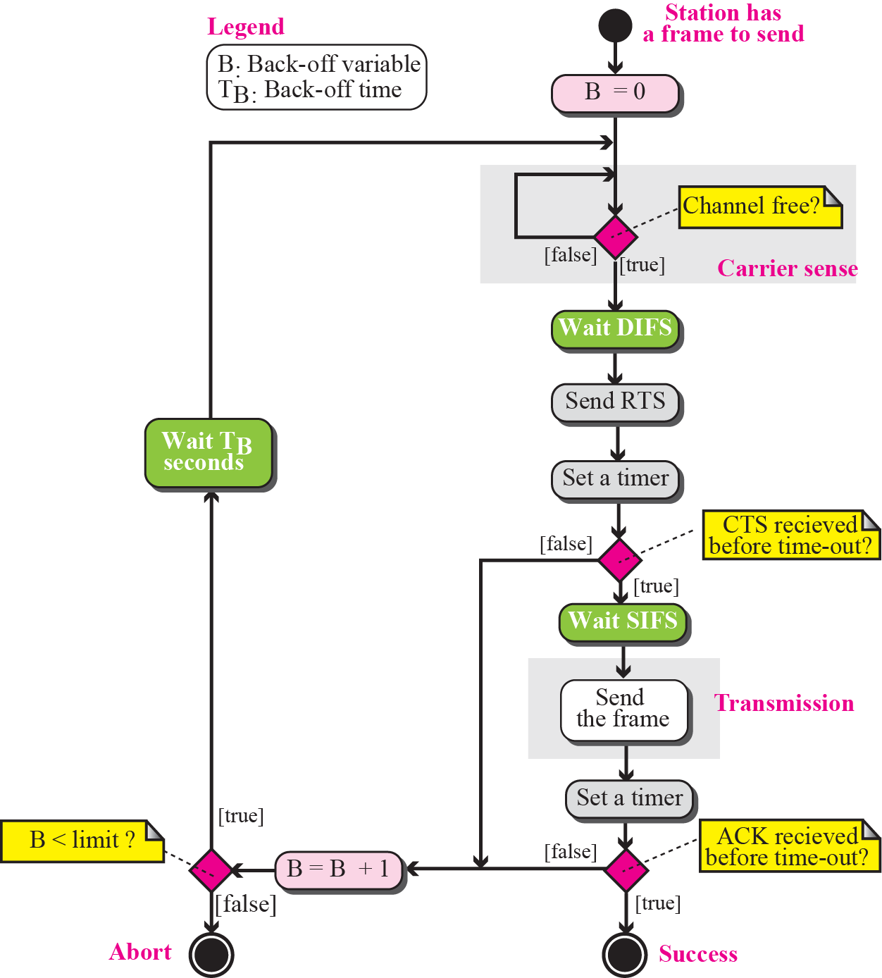
Figure 3.15 CSMA/CA flow diagram

Slide 47
Figure 3.16 CSMA/CA and NAV
Wireless LANs cannot implement CSMA/CD for three reasons:
For collision detection a station must be able to send data and receive collision signals at the same time. This can mean costly stations and increased bandwidth requirements.
Collision may not be detected because of the hidden station problem.
The distance between stations can be great. Signal fading could prevent a station at one end from hearing a collision at the other end.
Notes:
2CTS

Slide 48
Figure 3.16 CSMA/CA and NAV
When a station sends an RTS frame, it includes the duration of time that it needs to
occupy the channel.
Notes:
Before sending a frame, the source station senses the medium by checking the energy level at the carrier frequency.
RTS：Request to send，distributed interframe space (DIFS)
CTS：Clear to send，short interframe space，短帧间距

Slide 49
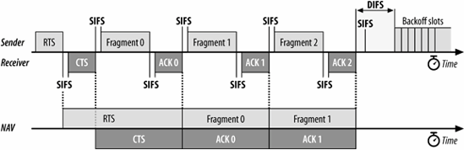
Fragmentation
The wireless environment is very noisy; a corrupt frame has to be retransmitted. The protocol, therefore, recommends fragmentation—the division of a large frame into smaller ones. It is more efficient to resend a small frame than a large one.

Slide 50
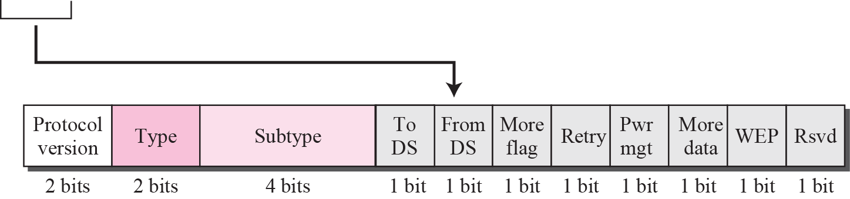
Figure 3.17 Frame format
Notes:
Addresses. There are four address fields, each 6 bytes long. The meaning of each address field depends on the value of the To DS and From DS subfields.
The FCS field is 4 bytes long and contains a CRC-32 error detection sequence.

Slide 51
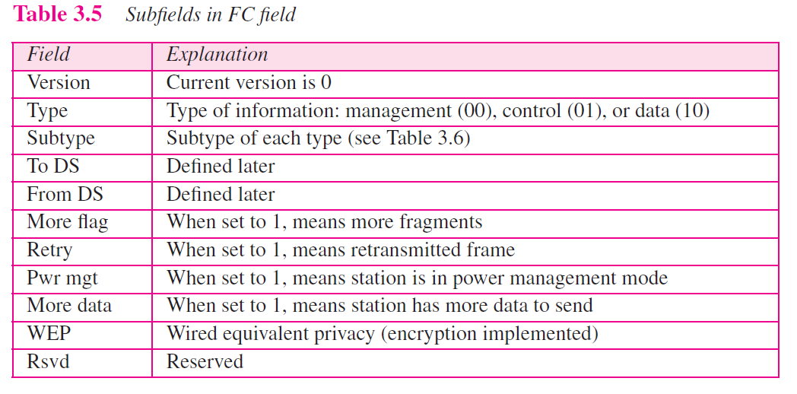
The FC field is 2 bytes long and defines the type of frame and some control information.

Slide 52
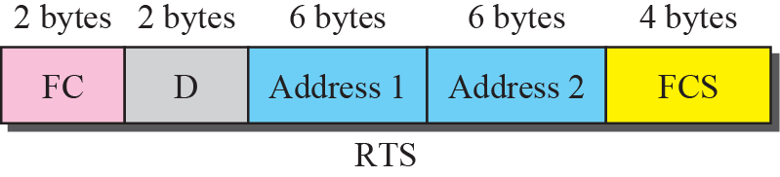
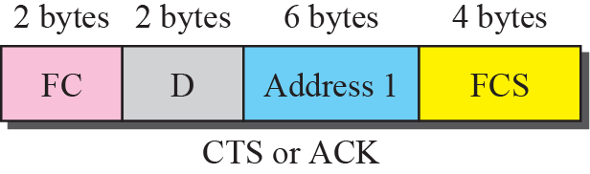
Figure 3.18 Control frames

Slide 54
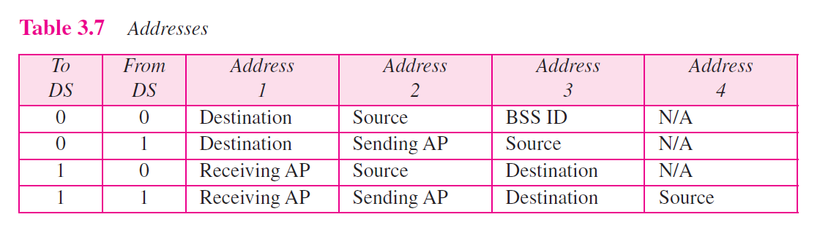
Note that address 1 is always the address of the next device.
Address 2 is always the address of the previous device.
Address 3 is the address of the final destination station if it is not defined by address 1.
Address 4 is the address of the original source station if it is not the same as address 2.

Slide 55
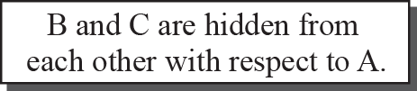
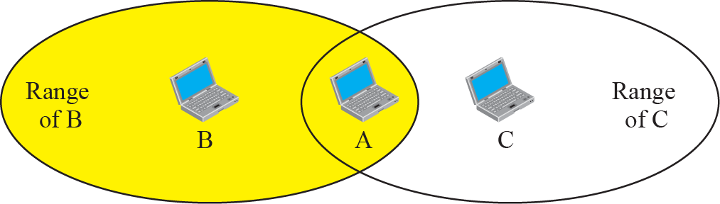
Figure 3.19 Hidden station problem

Slide 56
Note
The CTS frame in CSMA/CA handshake can prevent collision from a hidden station.

Slide 57
Figure 3.20 Use of handshaking to prevent hidden station problem

Slide 58
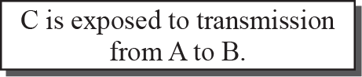
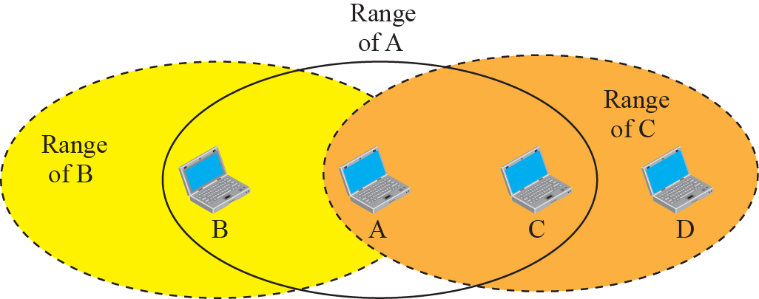
Figure 3.21 Exposed station problem

Slide 59
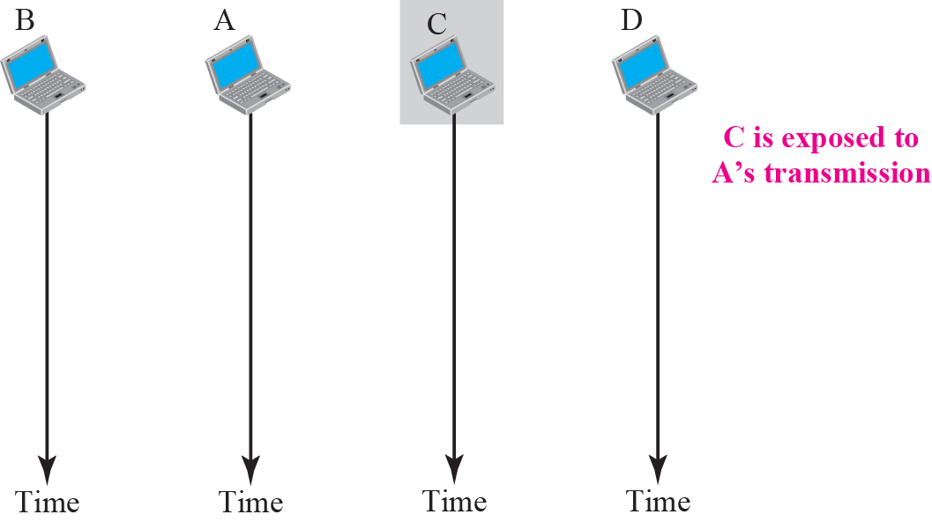
Figure 3.22 Use of handshaking in exposed station problem
Notes:
If station A has started sending its data, station C cannot hear the CTS from station D because of the collision; it cannot send its data to D. It remains exposed until A finishes sending its data.

Slide 60
Bluetooth
Bluetooth is a wireless LAN technology designed to connect devices of different functions such as telephones, notebooks, computers (desktop and laptop), cameras, printers, coffee makers, and so on.
A Bluetooth LAN is an ad hoc network, which means that the
network is formed spontaneously; the devices, sometimes called gadgets, find each other and make a network called a piconet.
Notes:
Piconet 微微网

Slide 61
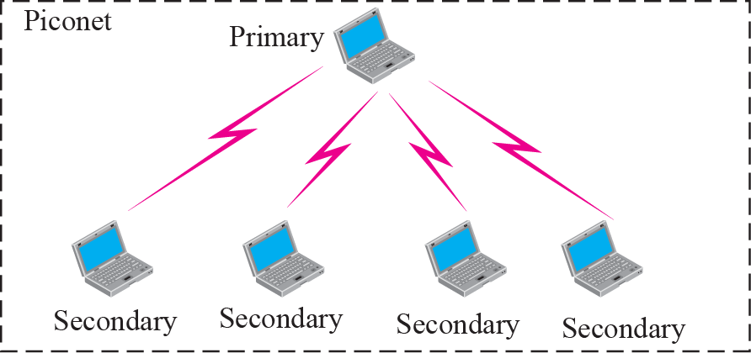
Figure 3.23 Piconet

Slide 62

Figure 3.24 Scatternet

Slide 63


Figure 3.25 Frame format types
Notes:
Access code. This 72-bit field normally contains synchronization bits and the identifier of the primary to distinguish the frame of one piconet from another

Slide 64
Chapter Outline
3.1 Wired Local Area Network
3.2 Wireless LANs
3.3 Point-to-Point WANs
3.4 Switched WANs
3.5 Connecting Devices

Slide 65
3-3 POINT-TO-POINT WANS
A second type of network we encounter in the Internet is the point-to-point wide area network. A point-to-point WAN connects two remote devices using a line available from a public network such as a telephone network. We discuss traditional modem technology, DSL line, cable modem, T-lines, and SONET.

Slide 66
Topics Discussed in the Section
65K Modems
DSL Technology
Cable Modem
T Lines
SONET
PPP

Slide 67


Figure 3.26 56K modem
Notes:
One may wonder why 56 kbps. The telephone companies sample voice 8000 times per second with 8 bits per sample. One of the bits in each sample is used for control purposes, which means each sample is 7 bits. The rate is therefore 8000 × 7, or 56,000 bps or 56 kbps.

Slide 68
Note
ADSL is an asymmetric communication technology designed for residential users; it is not suitable for businesses.

Slide 69

Figure 3.27 Bandwidth division
One channel is for control, and 24 channels are for data transfer. If there are 24 channels, each using 4 kHz (out of 4.312 kHz available) with 15 bits per Hz, we have 24 × 4000 × 15, or a 1.44-Mbps bandwidth, in the upstream direction.
Notes:
Channels 31 to 255 (225 channels) are used for downstream data transfer and control. One channel is for control, and 224 channels are for data. If there are 224 channels, we can achieve up to 224 × 4000 × 15, or 13.4 Mbps.

Slide 70

Figure 3.28 ADSL and DSLAM
At the telephone company site, the situation is different. Instead of an ADSL
modem, a device called a digital subscriber line access multiplexer (DSLAM) is installed that functions similarly to an ADSL modem. In addition, it packetizes the data to be sent to the Internet.

Slide 71

Figure 3.29 Cable bandwidth
Cable Modem
Cable companies are now competing with telephone companies for the residential customer who wants high-speed access to the Internet.
Notes:
This coaxial cable has a bandwidth that ranges from 5 to 750 MHz (approximately). The cable company has divided this bandwidth into three bands: video, downstream data, and upstream data

Slide 72


Figure 3.30 Cable modem configuration
The cable modem (CM) is installed on the subscriber premises. It is similar to an ADSL modem.

Slide 73




Access net: cable network
cable headend
…
cable
modem
splitter
C
O
N
T
R
O
L
V
I
D
E
O
V
I
D
E
O
V
I
D
E
O
V
I
D
E
O
V
I
D
E
O
V
I
D
E
O
D
A
T
A
D
A
T
A
1
2
3
4
5
6
7
8
9
Channels
frequency division multiplexing: different channels transmitted
in different frequency bands
Notes:
有线电视网络

Slide 74
Access net: cable network
time division multiplexing
The upstream data
bandwidth is only 37 MHz. This means that there are only six 6-MHz channels available in the upstream direction. A subscriber needs to use one channel to send data in the upstream direction. The question is, How can six channels be shared in an area with 1000, 2000, or even 100,000 subscribers?
The solution is time-sharing. The band is divided into channels; these channels must be shared between subscribers in the same neighborhood.
The cable provider allocates one channel, statically or dynamically, for a group of subscribers.
Notes:
the subscriber must wait until the channel is available. The situation is similar to CSMA discussed for Ethernet LANs.

Slide 75

T lines are standard digital telephone carriers originally designed to multiplex voice channels (after being digitized).

Slide 76
SONET
The high bandwidths of fiber-optic cable are suitable for today’s highest data rate technologies
Notes:
ANSI created a set of standards called Synchronous Optical Network (SONET) to handle the use of fiber-optic cables.

Slide 77
PPP
The telephone line or cable companies provide a physical link, but to control and manage the transfer of data, there is a need for a special protocol. The Point-to-Point Protocol (PPP) was designed to respond to this need.
PPP has only physical and data link layers.

Slide 78


Figure 3.31 PPP frame

Slide 79
Chapter Outline
3.1 Wired Local Area Network
3.2 Wireless LANs
3.3 Point-to-Point WANs
3.4 Switched WANs
3.5 Connecting Devices

Slide 80
3-4 SWITCHED WANS
The backbone networks in the Internet can be switched WANs. A switched WAN is a wide area network that covers a large area (a state or a country) and provides access at several points to the users. Inside the network, there is a mesh of point-to-point networks that connects switches. The switches, multiple port connectors, allow the connection of several inputs and outputs.
Switched WAN technology differs from LAN technology in many ways.

Slide 81
Topics Discussed in the Section
X.25
Frame Relay
ATM

Slide 82
Note
A cell network uses the cell as the basic unit of data exchange.
A cell is defined as a small, fixed-size block of information.

Slide 83

Figure 3.32 ATM multiplexing

Slide 84

Figure 3.33 Architecture of an ATM network

Slide 85

Figure 3.34 Virtual circuit

Slide 86
Note
A virtual connection is defined by a pair of numbers: the VPI and the VCI.

Slide 87

Figure 3.35 ATM layers

Slide 88

Figure 3.36 Use of the layers

Slide 89
Note
The IP protocol uses the AAL5 sublayer.

Slide 90

Figure 3.37 AAL5

Slide 91

Figure 3.38 ATM layer

Slide 92

Figure 3.39 An ATM cell

Slide 93
3-5 CONNECTING DEVICES
LANs or WANs do not normally operate in isolation. They are connected to one another or to the Internet. To connect LANs and WANs together we use connecting devices. Connecting devices can operate in different layers of the Internet model. We discuss three kinds of connecting devices: repeaters (or hubs), bridges (or two-layer switches), and routers (or three-layer switches).

Slide 94
Topics Discussed in the Section
Repeaters
Bridges
Routers

Slide 95

Figure 3.40 Connecting devices

Slide 96

Figure 3.41 Repeater or hub

Slide 97
Note
A repeater forwards every bit; it has no filtering capability.

Slide 98
Note
A bridge has a table used in filtering decisions.

Slide 99
Note
A bridge does not change the physical (MAC) addresses in a frame.

Slide 100

Figure 3.42 Bridge

Slide 101


Figure 3.43 Learning bridge
M
M
M
M

Slide 102
Note
A router is a three-layer (physical, data link, and network) device.

Slide 103
Note
A repeater or a bridge connects segments of a LAN.
A router connects independent LANs or WANs to create an internetwork (internet).

Slide 104

Figure 3.44 Routing example

Slide 105
Note
A router changes the physical addresses in a packet.

